Slide 1
Norm Evangelista
Software Engineering Candidate,
Flight Software Team

Slide 2
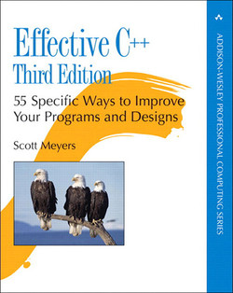
Why Vast Should Hire Me
Effective C++ by Scott Meyers inspired me to start writing C++ in 1992.
I’m a disciple of best practices in software development.
I’m a well-rounded software engineer; I’ve been involved in all aspects of the software development lifecycle.

Slide 3
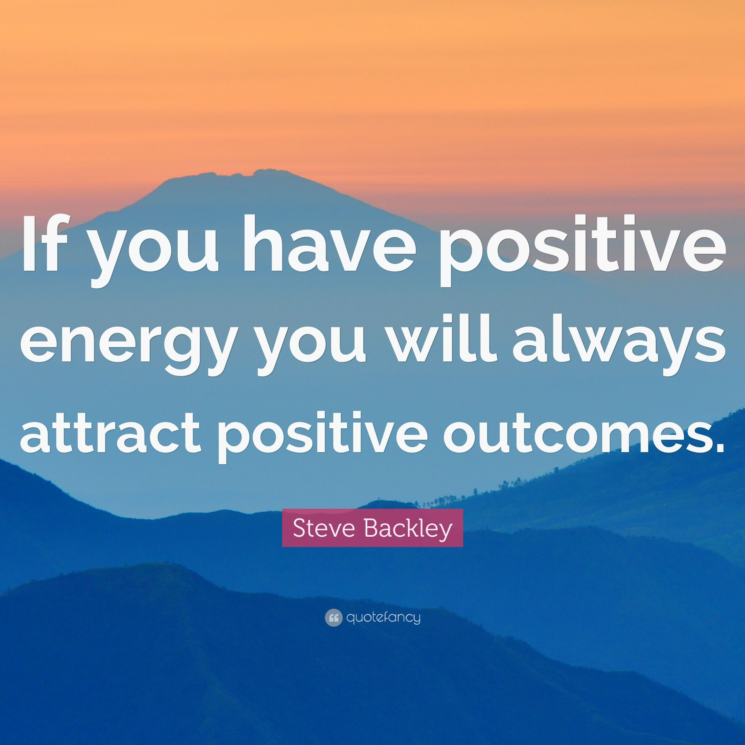
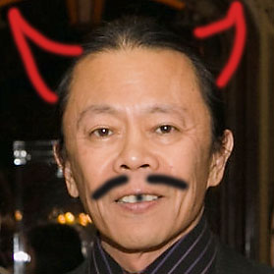
Why Vast Should Hire Me
I bring positive energy to any team.
I’m handsome, intelligent,
quiet, and modest.

